Slide 1
GROUP 10

Slide 2
POINT OF SALES SOFTWARE (PATUPA)
Nyarko George (Group leader)
Nyefere Edith Asantewaa
Bornaah Paul
Opintan Jacob
Fianyigborlo Abednego
Mensah Benjamin
Farida Alhassan Sakibu
Inkoom Buabeng James
Abdullah Huzaifa Mensah
Sumela Ahmed
PS/CSC/21/0003
PS/CSC/21/0031
PS/CSC/21/0034
PS/CSC/21/0056
PS/CSC/21/0063
PS/CSC/21/0075
PS/CSC/21/0105
PS/CSC/21/0142
PS/CSC/21/0143
PS/CSC/21/0148

Slide 3
AIM
To offer a user-friendly and easily navigable point-of-sale (POS) system that empowers store owners, managers, and cashiers to proficiently oversee product inventories, customer interactions, and payment procedures.

Slide 4
OBJECTIVE
Our goal is to provide small convenience stores with a reliable point-of-sale system that is simple to use and has comprehensive administration and cashier features to improve operational efficiency, minimize manual errors, and facilitate seamless transactions.

Slide 5
KEY FEATURES OF THE APPLICATION
CASHIER PANEL
Login: When the software first launches, this is the page that appears. The radio button that says "Cashier" must be selected by the cashier for them to access the cashier panel. He or she must input their cashier's ID in the first box.
Selling product items with cash: When you want to sell an item, simply "double-click" it on the table on the left side. When you "double-click" a table row, the item you selected appears in the "sale items" table, which is on the right side. When an item reaches the "sale items" table, the value is calculated based on the percentage of promotion and the quantity of the products.
Search product items: Products can be found through name and barcode searches. By scanning the barcode using an Android application, you can also locate the product goods.

Slide 6
KEY FEATURES OF THE APPLICATION
Administrator’s Panel
Login Page: This is the first page you will see when running the software. Enter the admin panel by selecting the admin option button. Fill out the first box with your admin username. In the second box, enter your password. After filling in all the boxes, he or she must click the “login” button.
Manage Product Items: This panel displays all the product items in the database. You can search for product items by name or barcode. You can also make changes to the product in this panel. To edit a product item, simply "double-click" on it. Double-clicking an item will display its data on the left side of the table.
Manage Product Category: You can manage product category in this panel. Whenever you want to add a new category, you have to click the “new” button to generate a new category ID. Then, you have to add the category name and click the add button. If you want to delete the product category, you can select the item you want to delete.
Manage Cashier: You can manage cashiers in this panel. Like the previous panel, you can also do all the staff like the other

Slide 7
KEY FEATURES OF THE APPLICATION
Popular Item: In this panel, you can see the most popular items in the store. The system generates items in descending order to their popularity.
Manage Supplier: You can use this to manage suppliers. Similar to other panels, you can do operations such as adding, updating, and deleting staff. Unlike product categories, deleting suppliers associated with product items is not permitted.
Chart View: In the chart view panel, 3 types of charts are provided. Each chart points to different types of information.
Report Generation: This feature provides you to see the summary report over the store for daily and monthly.

Slide 8
KEY FEATURES OF THE APPLICATION
Daily Sale Chart: This chart provides you to see the daily sale amount within this current month
2. Category Sales: This chart shows which category in the store is the most selling category by pie chart.
3. Monthly Sale : Monthly sale chart provides monthly sale amount in the current year
4.Report: This panel will provide you to see the summary report over the store for daily and monthly. You can generate them by clicking each button. After you click, the reports will show in another user interface. You can save them as PDF file as well as print them to paper like receipt voucher.

Slide 9

Application logo

Slide 10
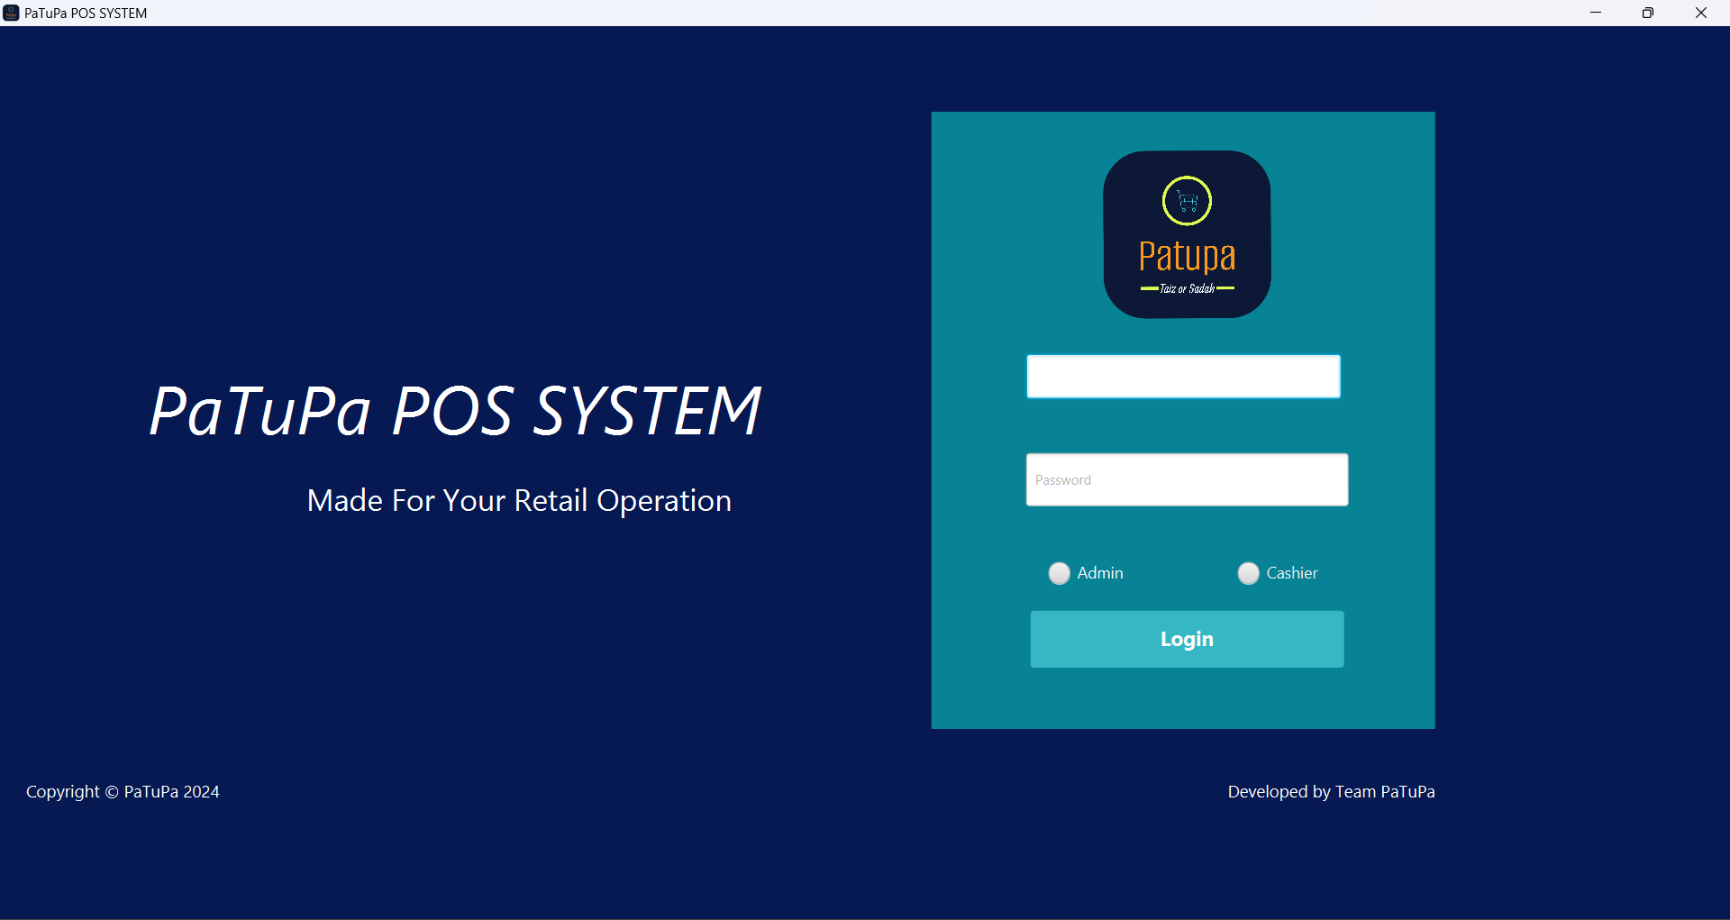
APPLICATION SCREENSHOTS

Slide 11
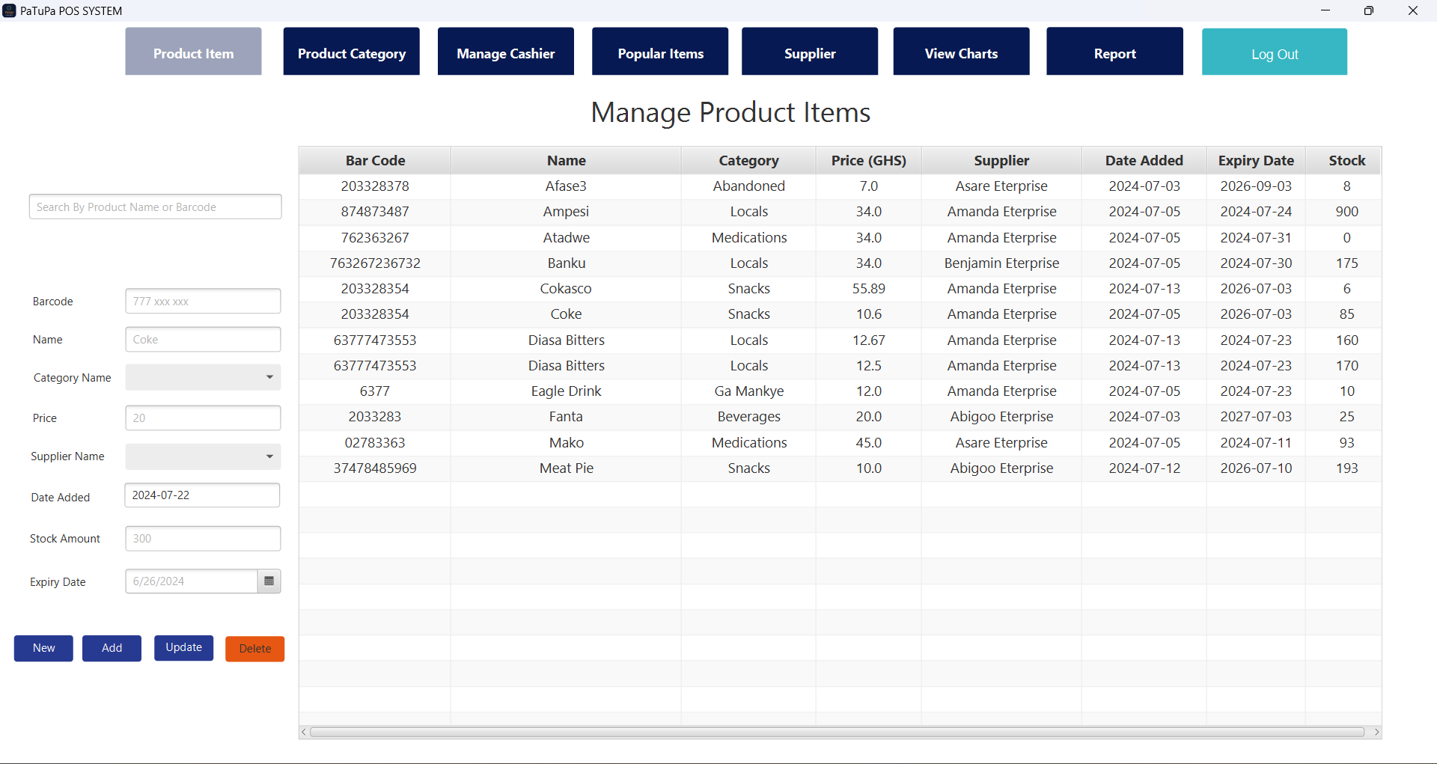
ADMIN INTERFACE

Slide 12
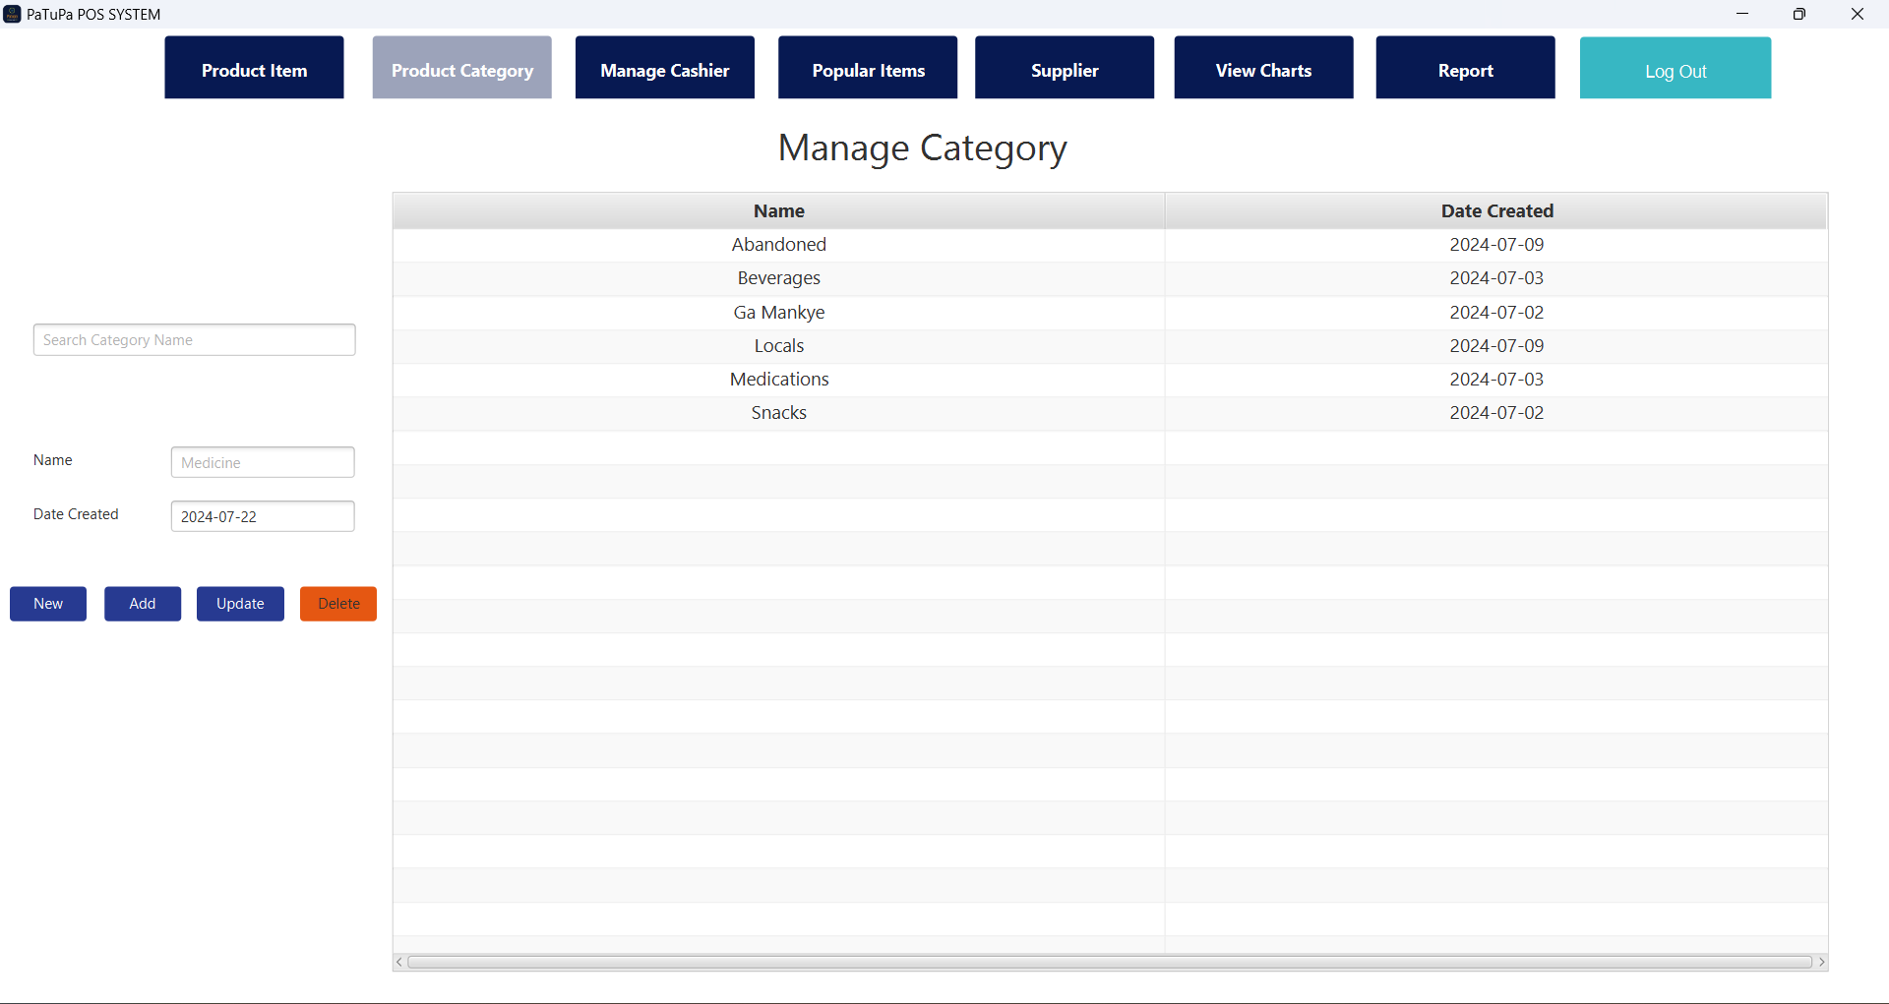
Product category panel

Slide 13
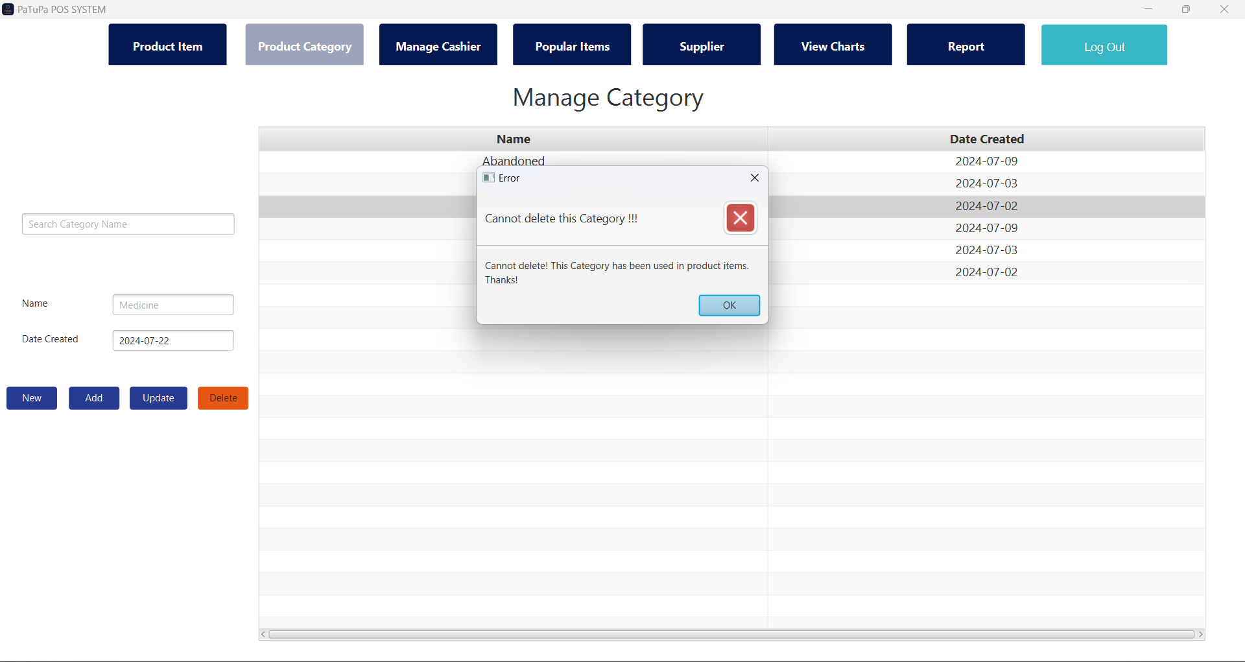

Slide 14
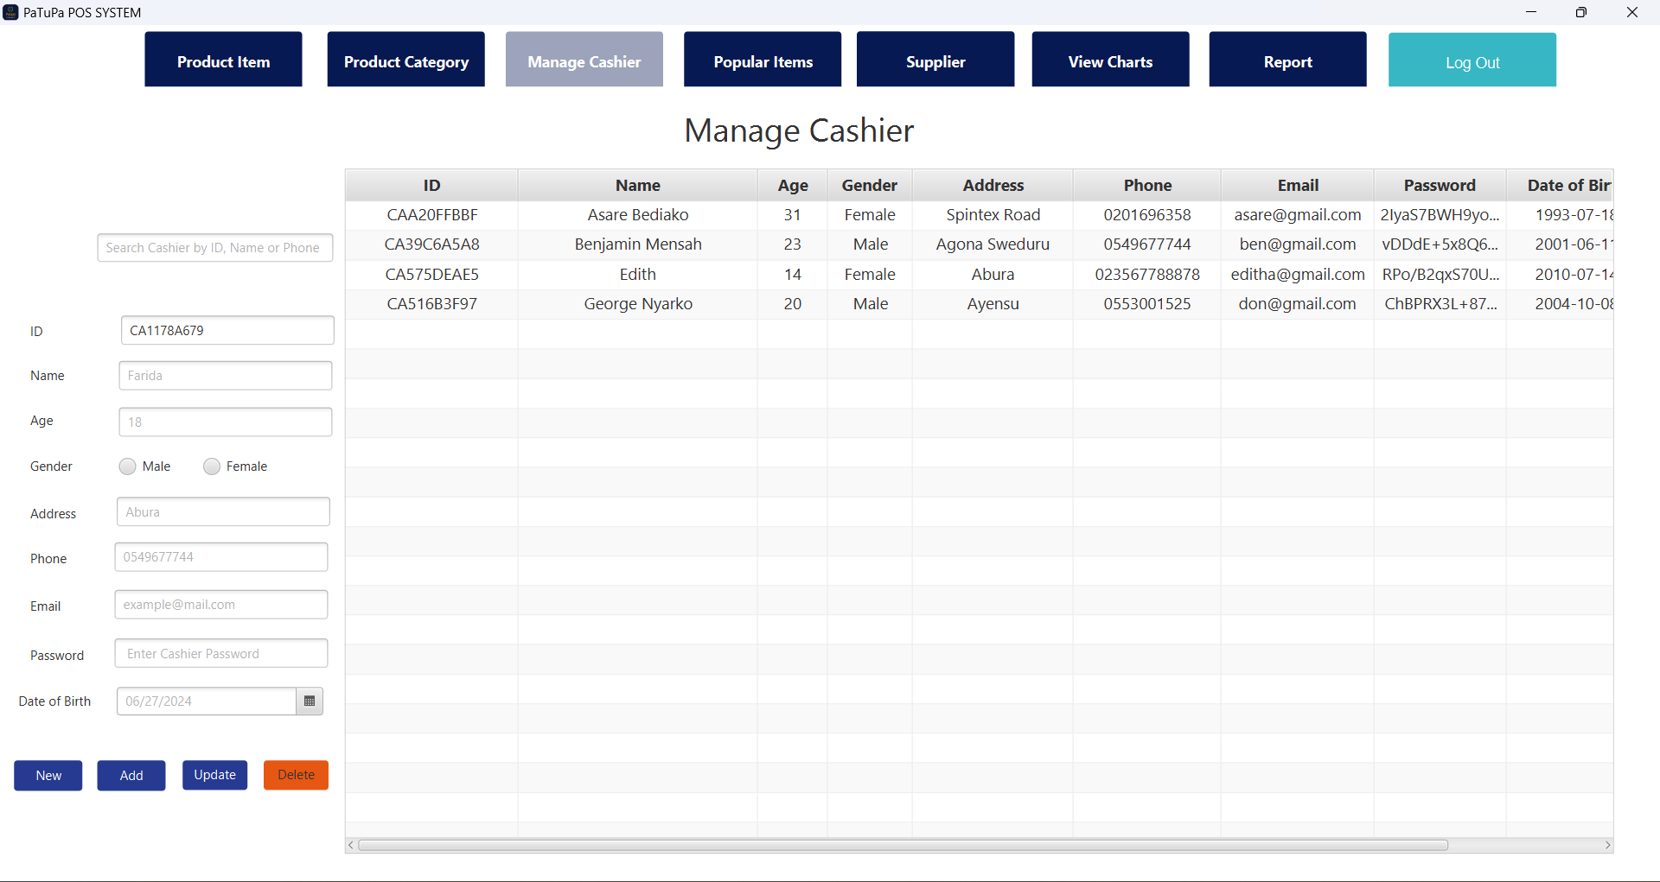
Manage Cashier panel

Slide 15
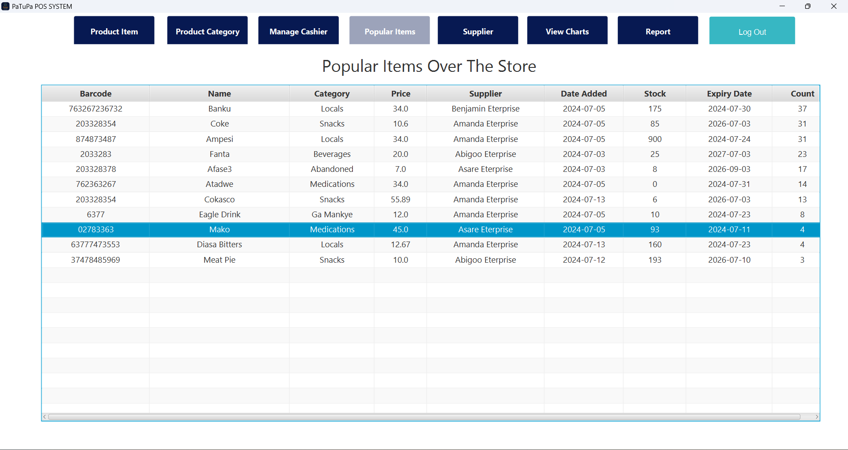
POPULAR ITEMS PANEL

Slide 16
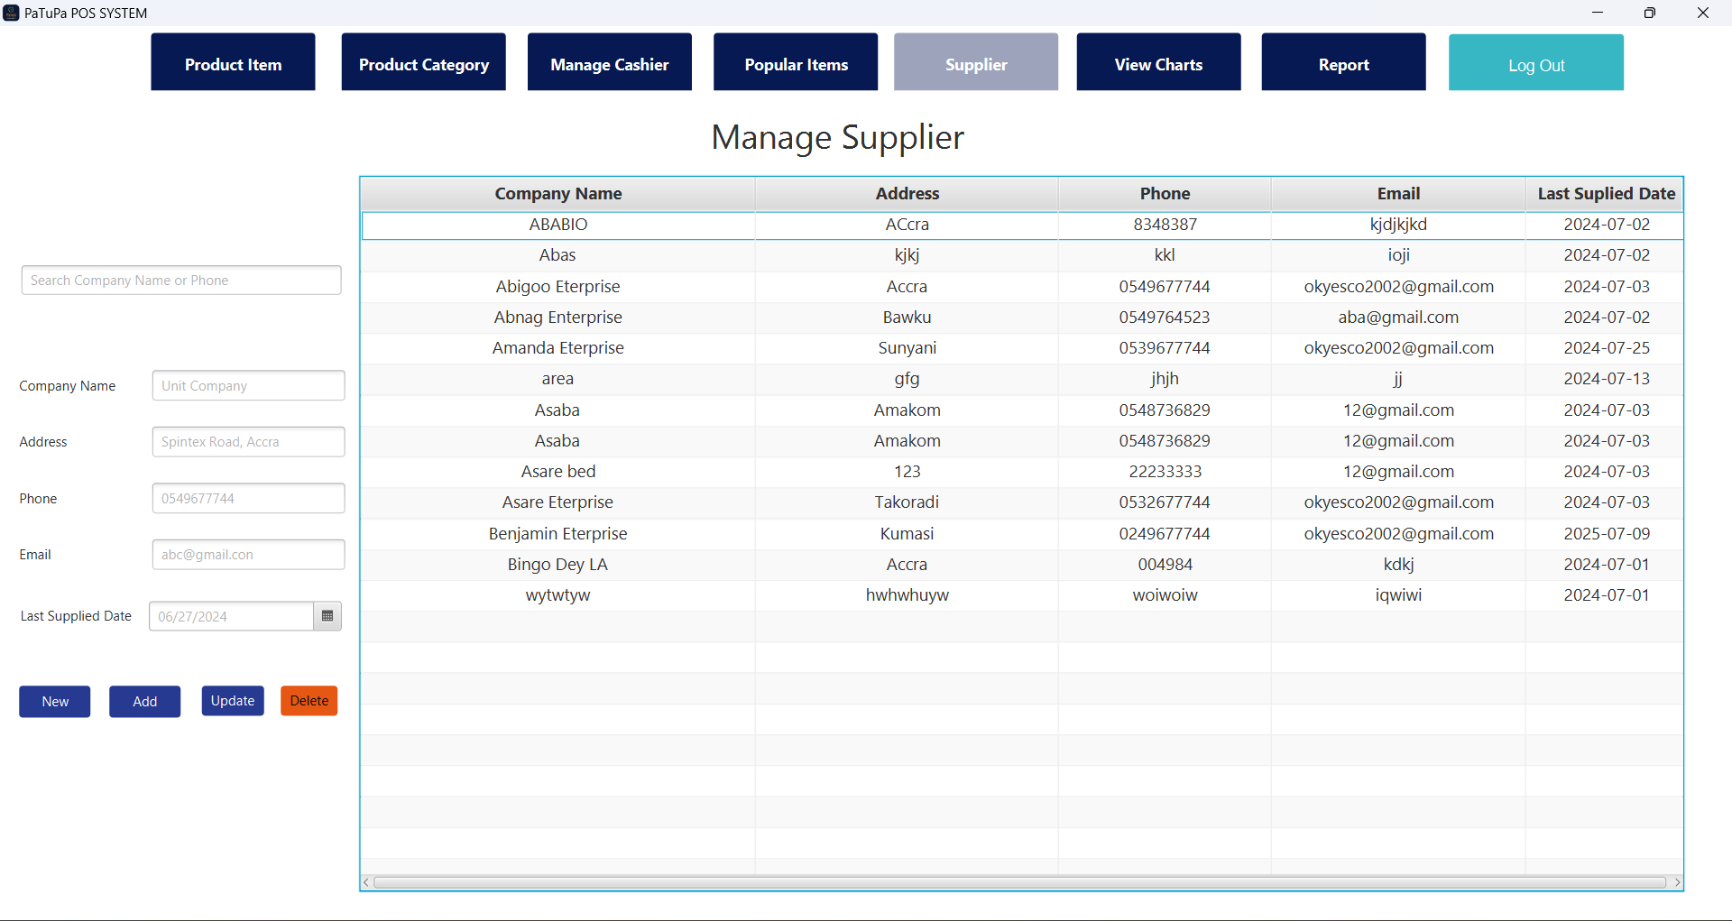
SUPPLIER PANEL

Slide 17
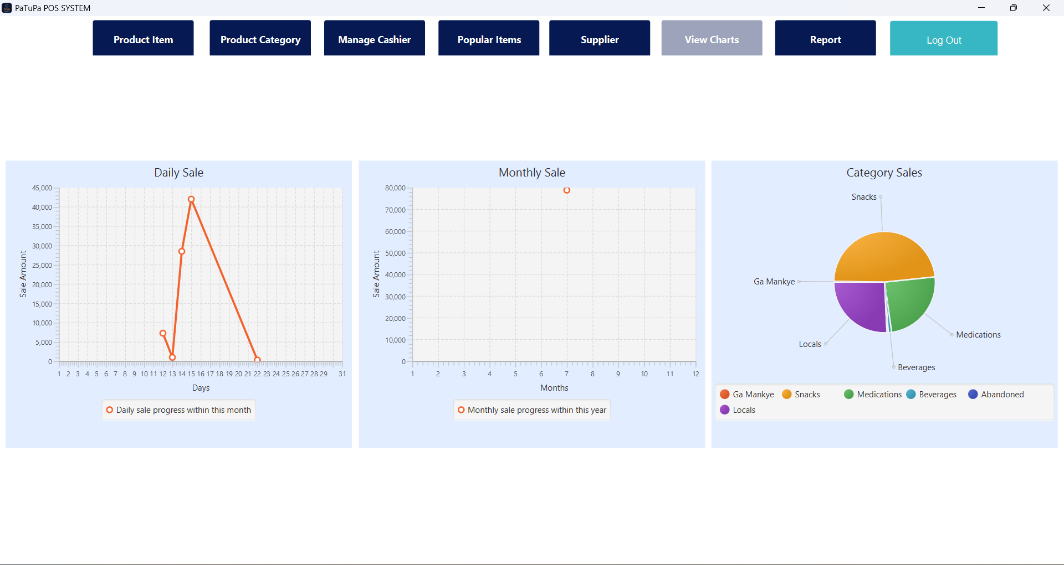
chart PANEL

Slide 18
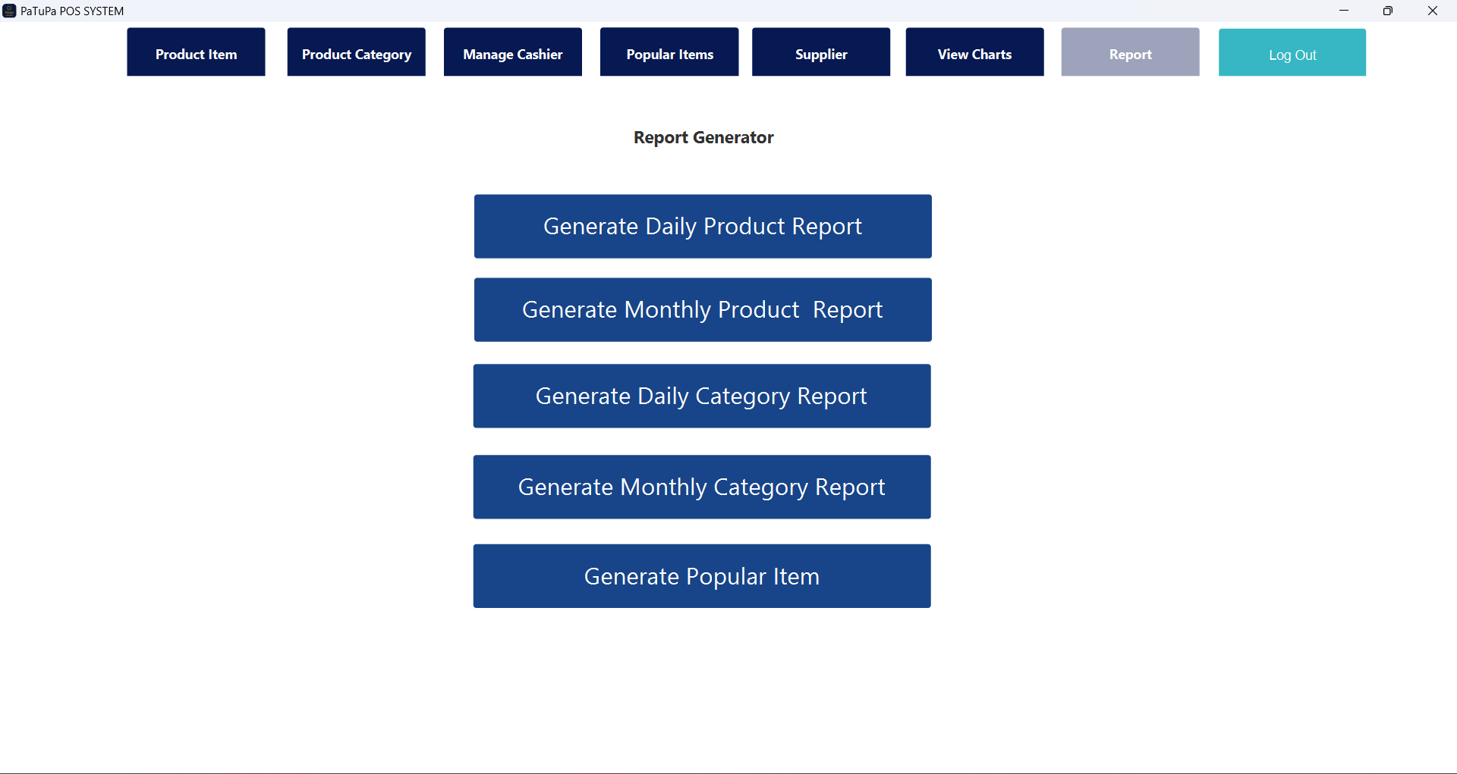
REPORT GENERATOR PANEL

Slide 19
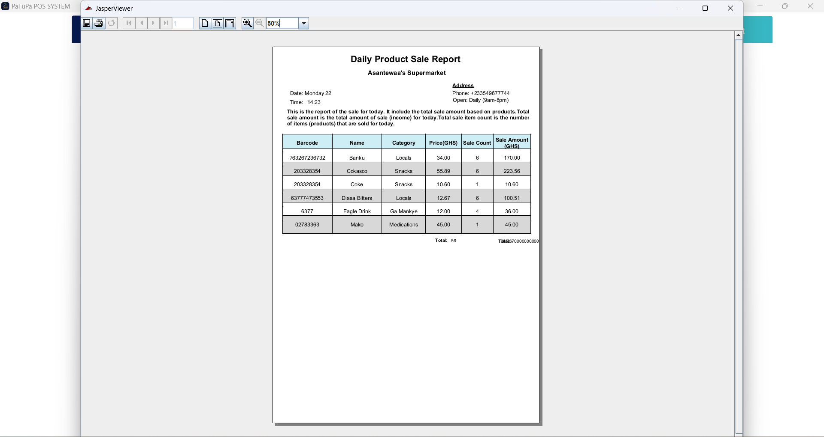
REPORT GENERATOR PANEL

Slide 20
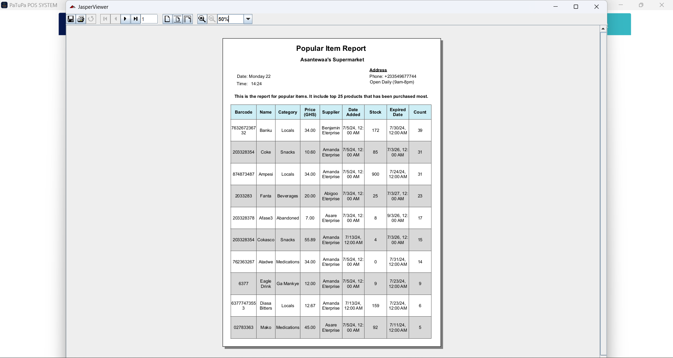
REPORT GENERATOR PANEL

Slide 21
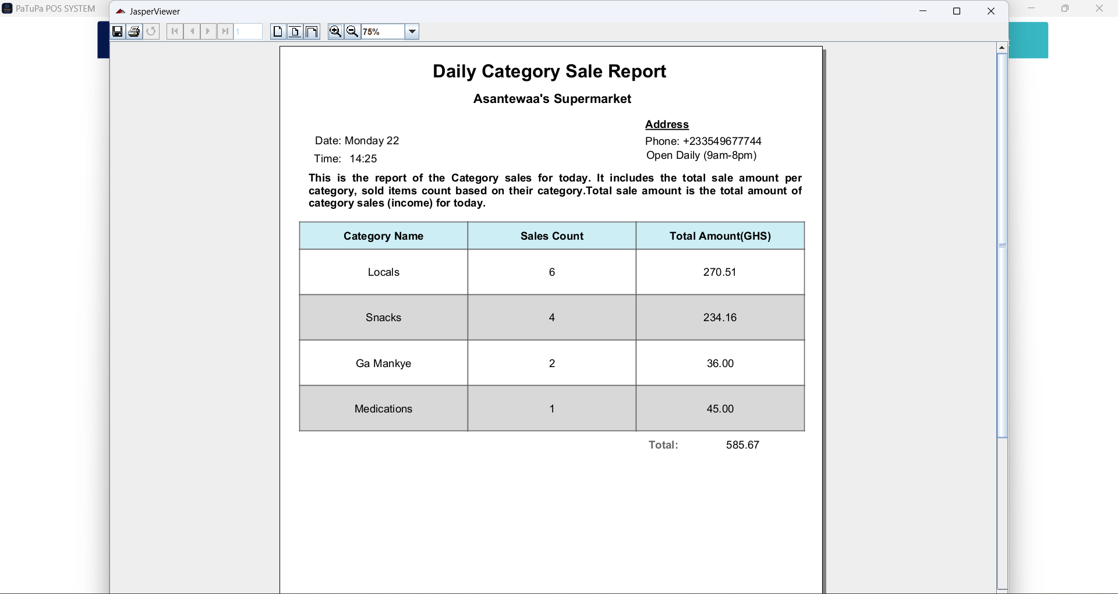
REPORT GENERATOR PANEL

Slide 22
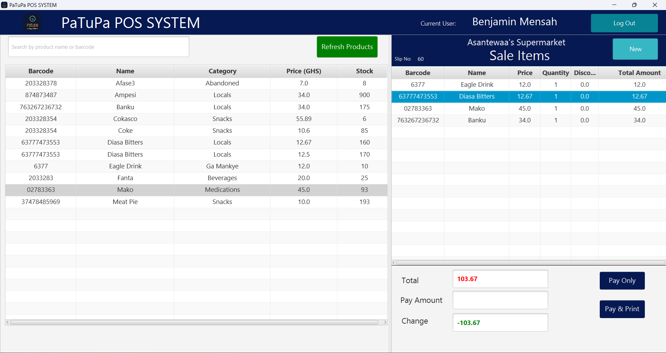
CASHIER PANEL

Slide 23
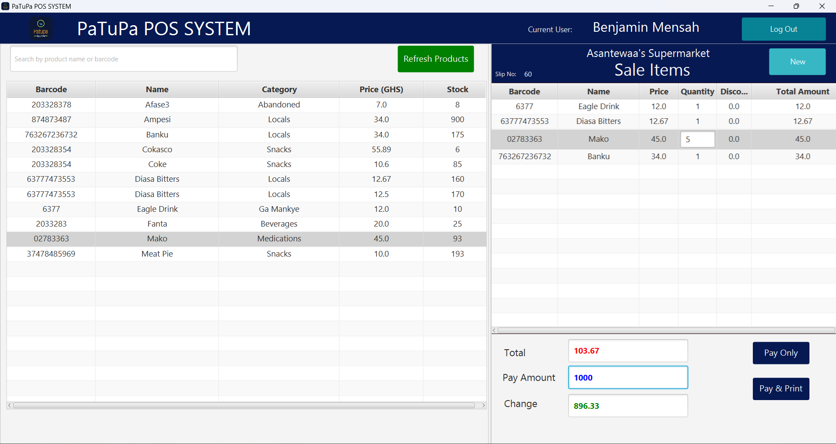
CASHIER PANEL

Slide 24
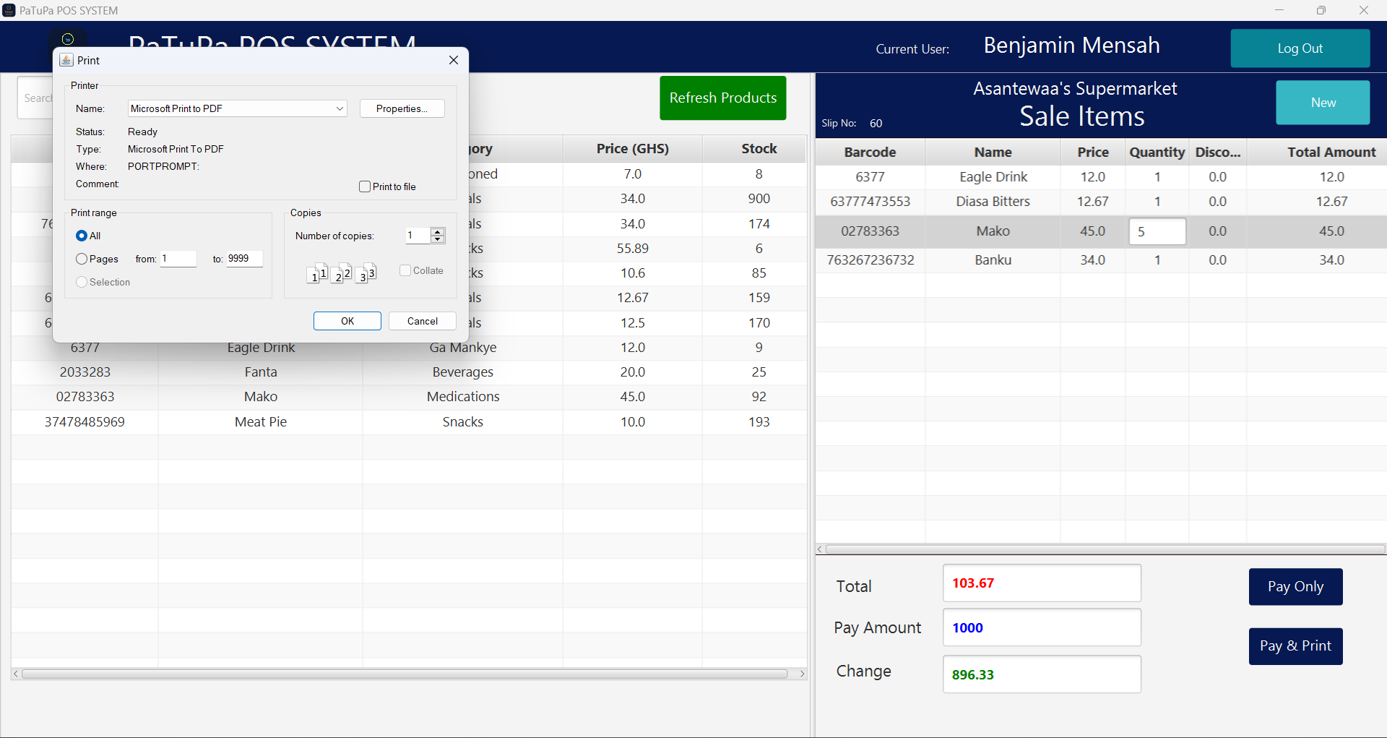
CASHIER PANEL

Slide 25
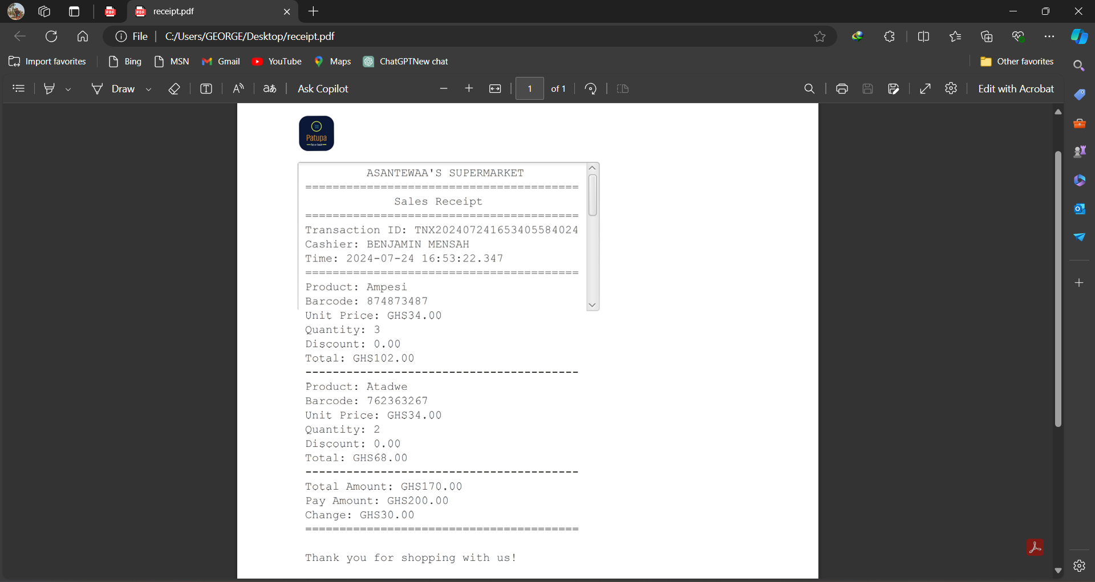
CASHIER PANEL

Slide 26
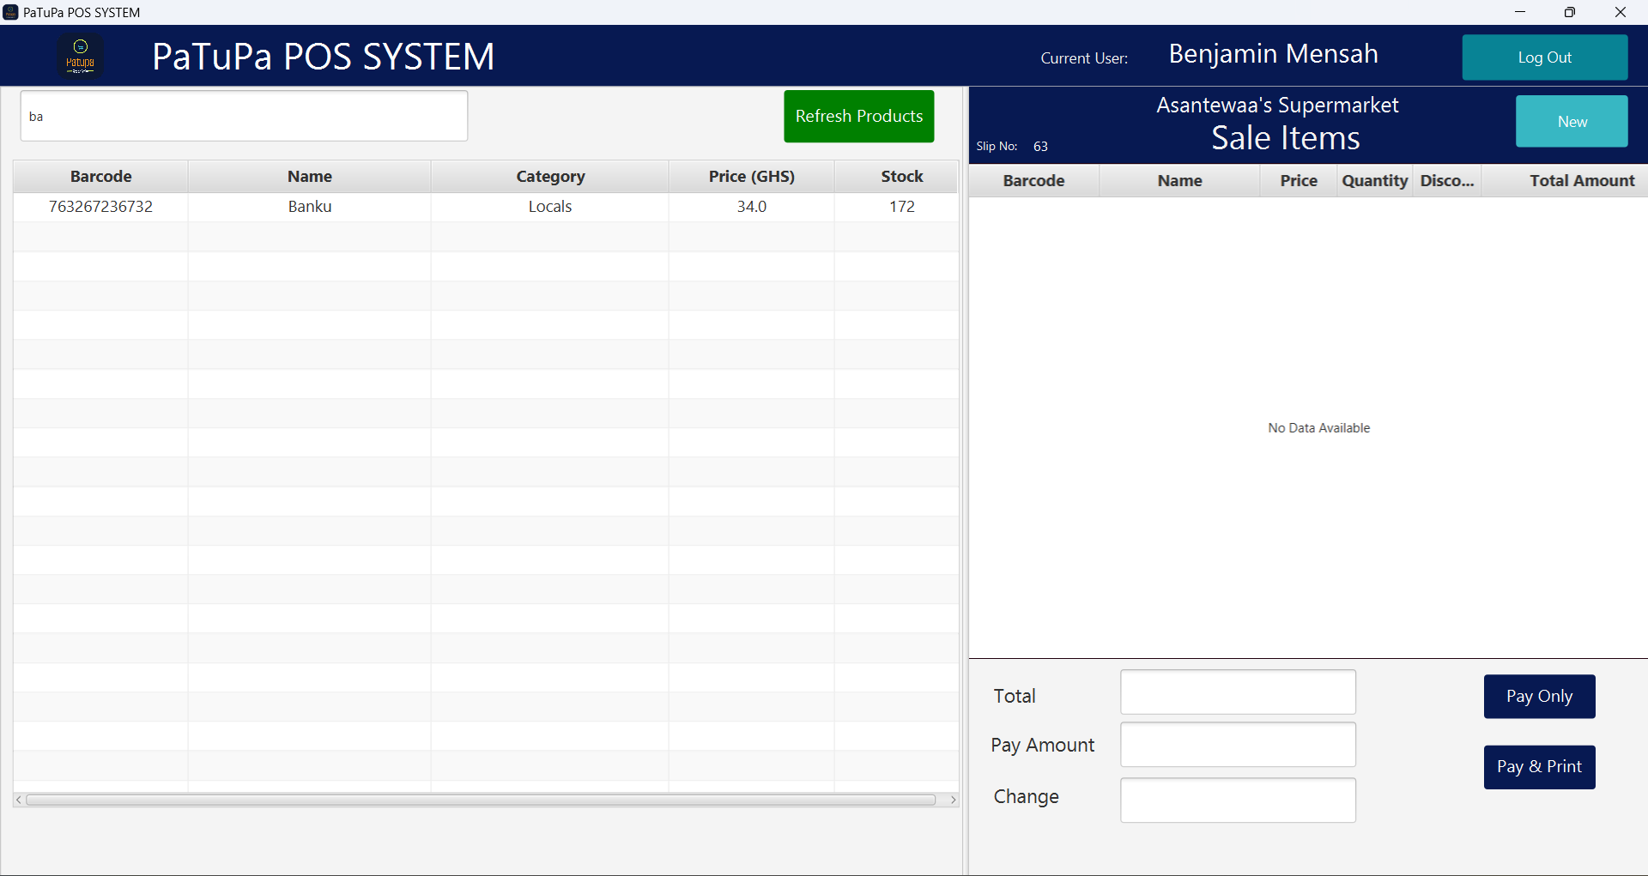
CASHIER PANEL

Slide 27
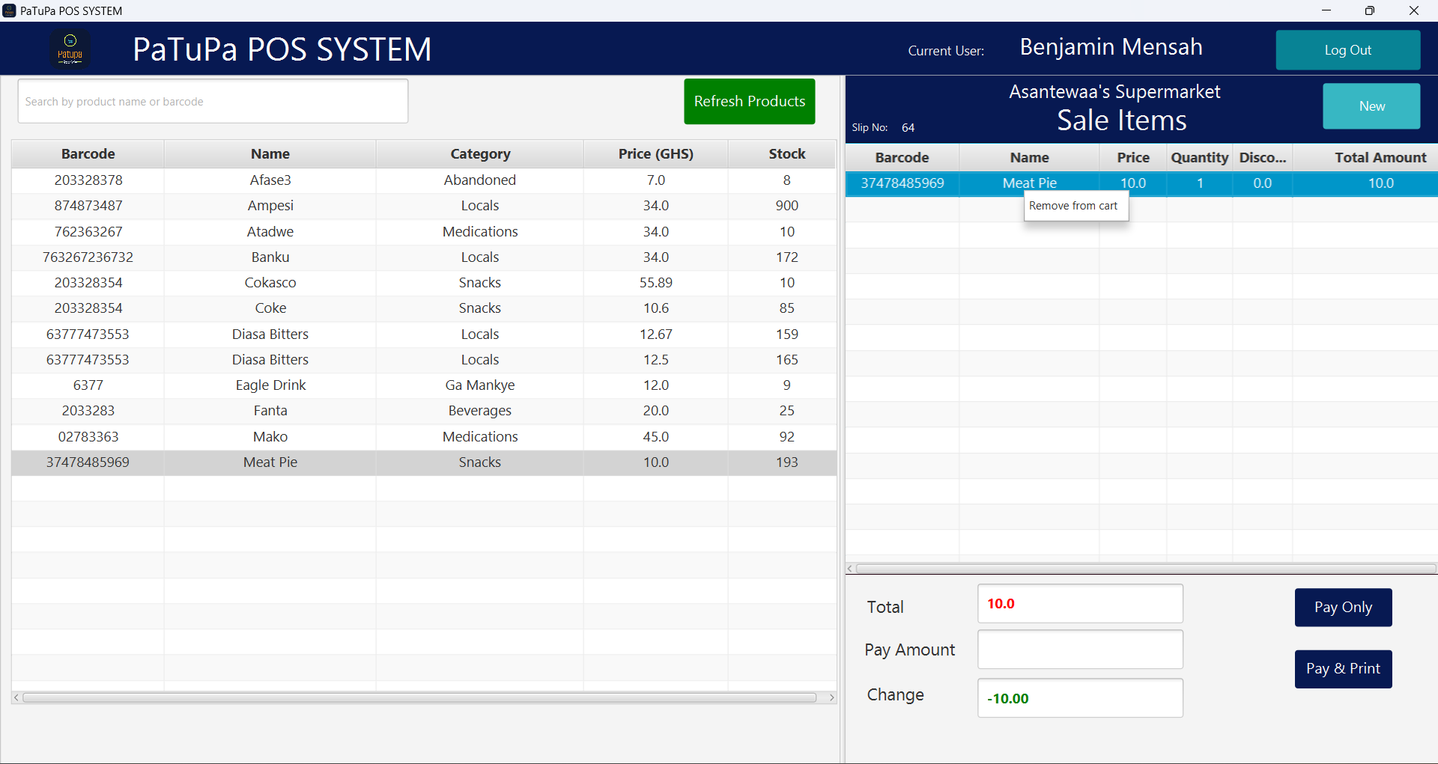
CASHIER PANEL

Slide 28
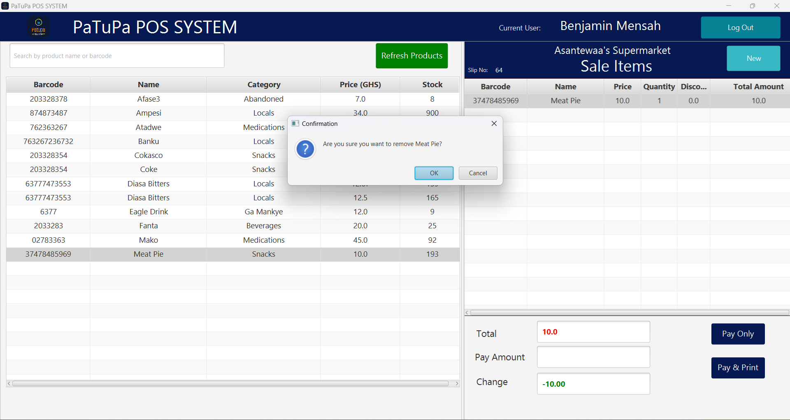
CASHIER PANEL

Slide 29
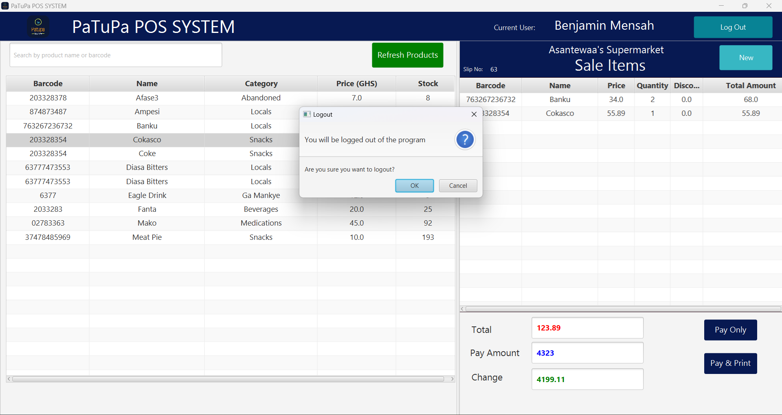
CASHIER PANEL

Slide 30


